Slide 1



Continuous Integration - Selenium - MXUnit - Jenkins
“Imperfect tests, run frequently, are much better than perfect tests that are never written at all.”
~ Martin Fowler

Slide 2
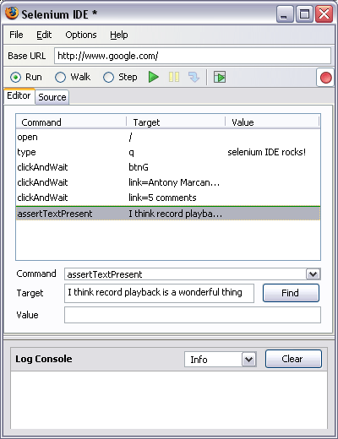
Selenium
Selenium automates browsers. That's it. What you do with that power is entirely up to you.
Selenium IDE
CFSelenium

Slide 3
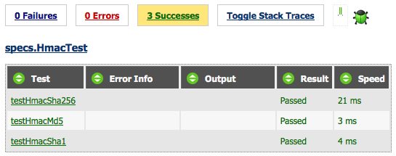
MXUnit
A testing framework for use in testing components (cfc’s). It is not useful for testing output: HTML, Javascript, CSS, etc.
Eclipse plugin
Ant integration
Actively developed

Slide 4
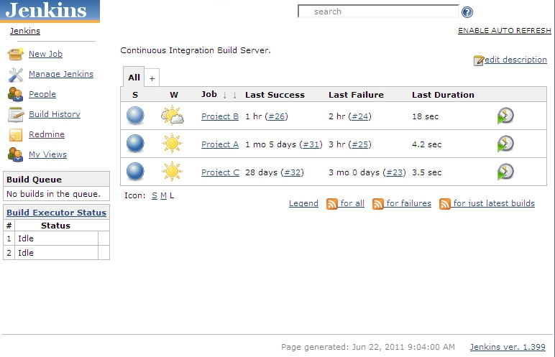
Jenkins
Jenkins is an open source continuous integration tool .
Supports MXUnit and Selenium

Slide 5
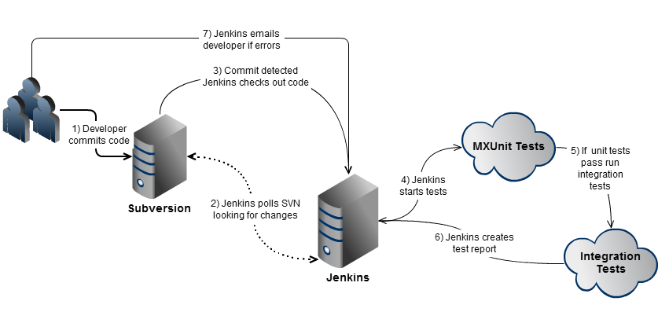
The Big Picture

Slide 6
What To Test
“If you don’t like unit testing your product, most likely your customers won’t like to test it either.”
~Anonymous
Ideal = Test everything (TDD).
Reality = Test what you can.
Bugs = All bugs should have a test to verify they don’t recur.

Slide 7
Getting Started
“Later equals never.” ~Robert C. Martin
No CFCs: Selenium tests (smoke tests).
CFCs: MXUnits tests.
Bugs: Write a test to verify the bug is fixed.

Slide 8

Demo
Selenium IDE
CFSelenium
Selenium RC
MXUnit
Ant
Jenkins

